Slide 1
SSM Workshop on Credit Granting & Pricing
Day 1 Retail | Section 2: Acquiring the client
Skeleton deck
September 2026 WORK IN PROGRESS

Slide 2
Consumer Loans Growth Strategy
Consumer lending is a profitable growth engine, driven by market leadership and strong digital contribution
~30%
+106%
32%
54%
~€30m
consumer loan new production market share
increase in disbursements from 2021 to 2025
digital contribution by value
digital contribution by volume
net profit in 2025
Growth is driven by three strategic pillars: digital journeys, customer-focused propositions and commercial excellence
Pillar I
Pillar II
Pillar III
Digital Customer Journeys
Customer-focused Product Proposition
Commercial Excellence
Operationalize personalization across digital and physical touchpoints
Tailor products and pricing to low-risk / high-value segments
Use analytics and always-on campaigns to convert demand into sales
Consumer Loans Growth Strategy
Notes:
Consumer lending is a profitable business line for the Bank, with around €30 million net profit in 2025 and strong new production momentum. The storyline is simple: market leadership is protected not by a single product, but by a repeatable growth model built on digital journeys, propositions and commercial excellence.

Slide 3
Consumer Loans Strategic Initiatives: Customer Journeys
Pillar I: Digital Customer Journeys
Deliver the right consumer loan proposition to the right customer across every touchpoint
Operationalize personalization by redesigning the digital journey and simplifying the path from need recognition to application.
Personalized digital proposition
Simplified loan application process
Performance indicators
Personalized
proposal
Tiles ordering
○
One-stop shop for loans across branches and digital channels.
Auto Decisions
81%
○
Digital signature through digital box.
average for all products
○
Auto-retrieve financial and customer data for existing customers.
Oct ’24
Always-on
pre-advised limits
Wizard tool
○
Checker simplification at branch level.
Digital Penetration
○
Dynamic, parametric and prioritized display of eligible propositions through e-banking and m-banking.
○
Automated decisions to improve speed and scalability.
YTD 2024 | Digital & Hybrid Sales
71%
○
Remote servicing through e-gov.gr where applicable.
YTD 2024 | Digital Sales
51%
○
Personalized amounts, installments and pricing across dashboard, product tiles, pages and online wizard.
Customers see the products they are eligible for, based on profile, previous activity and business priority.
NPS
73 - 76
digital
physical
“Find the loan that suits me” wizard guides customers to the most relevant proposition using business rules and customer responses.
Business impact
Higher conversion
Better customer experience
Lower acquisition cost
Greater scalability
Consumer Loans Growth Strategy
Notes:
Suggested speaker note: This slide combines the strategic objective and the operational delivery of the first growth pillar. The key message is that digital customer journeys are not only a channel improvement, but a growth enabler. We are redesigning the way propositions are displayed, prioritized and personalized, while also simplifying the application process and increasing automation. The impact is visible through stronger digital penetration, high auto-decision levels and strong NPS across digital and physical channels.

Slide 4
Consumer Loans Strategic Initiatives: Offering
Pillar II: Customer-focused Product Proposition
Expand the product range and tailor features, pricing and servicing to the specific needs and risk profile of each segment.
Segment-based & purpose-led propositions
Public Sector
Payroll deduction; low defaults and attractive pricing.
PB Prime/ Cash Plus
Affluent customers; tailored limits and preferential pricing.
Group Sales
Payroll relationship; repayment aligned with salary date.
Green / Student Purpose
Specific needs, differentiation and expanded coverage.
Delivered product propositions
Fast Loans
My Fast Loan
Public Sector Loan
Group Sales Loan
PB Prime
Cash Plus
12.0% of disbursements
pre-advised limits
26.2% of disbursements
40.8% of disbursements
7.4%
1.0%
Speed & simplicity
Personalized digital offer
Unique market offering
Payroll-based proposition
Affluent
PB Standard
▪
Small loan amount; minimum documentation.
▪
Preselected customers with limits based on advanced analytics.
▪
Installments paid directly from Public Agencies.
▪
For Group Sales customers with salary account relationship.
▪
Exclusive to PB Prime customers.
▪
Exclusive to PB Standard customers.
▪
Automation rate >90% and time-to-money up to 15 min.
▪
Personalized amount, instalment and pricing displayed digitally.
▪
Excellent performance and low default rates.
▪
Installments synced with payroll date.
▪
Favorable pricing.
▪
Targeted pricing by profile.
▪
Best-selling product via Mobile App.
▪
Supports higher conversion with targeted eligibility.
▪
>70% approval rate.
▪
Highest contribution to new disbursements.
▪
>83% approval rates.
▪
High approval rates.
Next-wave propositions
……….
Consumer Loans Growth Strategy
Notes:
Suggested speaker note: This slide shows the second pillar of our consumer loans strategy. The key point is that our offering is not one-size-fits-all. We have built segment-based propositions around low-risk and high-value customer groups: Public Sector, Group Sales and Personal Banking. My Fast Loan is shown separately because it is not just a fast loan variant; it is a pre-advised, analytics-driven proposition that supports personalization and digital conversion. Going forward, we will continue to expand with cards in pre-advised journeys, active credit limit management, risk-based pricing, top-up loans and open-line concepts.

Slide 5
Pillar III: Commercial Excellence
Turn journeys and propositions into measurable sales through analytics and personalization
Objective
Create an omni-channel commercial engine where each customer sees the most relevant lending proposition at the right moment.
Key capabilities
35+ automated campaigns
always-on activity across channels
Real-time decisioning
right offer at the moment of need
Personalized digital assets
dashboard, floating banners and push notifications
Closed-loop actions
abandoners and approved-not-signed follow-up
Test & learn
lean creative outperformed traditional BTL material
Risk….?????
…….
Business impact
Higher conversion, stronger digital share, better cross-sell and more efficient acquisition through data-driven commercialization.
Next-wave propositions
GenAI in customer journeys?
……….
Consumer Loans Growth Strategy
Notes:
The commercialization pillar ensures that the output of the first two pillars actually translates into sales. The objective is to move from campaign-by-campaign execution to an always-on and personalized commercial engine.

Slide 6
ERB Disbursements Consumer Loans
CL Growth Transformation Pillar 2021-2023
ERB Consumer Loans New Disbursements
(€m)
Highlights
Leading position between the 4 systemic banks.
Continuous YoY increase of new disbursements of over 15%, in the last 4 years.
Almost doubling total disbursed amounts from 2021 to 2024.
67% of new production consists of Payroll Loans.
More than 50% of Consumer Loans originate from digital channels.
Consumer Loan OBs stand at ~€560m.
Data as of Oct 2024

Slide 7








Consumer Loans - Strategic Pillars
Consumer Loans
Strong market position: Leading share in new production (~30%) with sustained growth (+106% € increase in disbursements from 2021 to 2025)
Digital acceleration: Multichannel strategy with growing digital contribution (currently 32% value / 54% volumes), increasing digital sales contribution by 52% between 2021 and 2025.
Customer-focused propositions: Personalized offerings for low-risk/high-value segments
Advanced capabilities: Analytics, real-time campaigns & GenAI improving targeting, efficiency & experience
Retain Market Leadership position & drive market growth via continuous innovation and portfolio leverage
Offering: Expand across channels & cover all segment needs
Journeys: Restructure CL Journey Capitalizing Always on
Consumer Lending Growth
Commercial Plan: Always on, Real Time & Personalization

Slide 8
Pillar II: Customer-focused Product Proposition
Segment-based propositions for selected low-risk and high-value customers
Objective
Expand the product range and tailor features, pricing and servicing to the specific needs and risk profile of each segment.
Public Sector
Payroll deduction before salary credit; exceptionally low defaults and attractive pricing.
Group Sales
Salary paid through Eurobank; repayment aligned with payroll date and strong credit performance.
Personal Banking
Affluent customers with stronger profiles; tailored limits and preferential pricing.
Green / Purpose Loans
Dedicated propositions to cover specific customer needs and support differentiation.
Next-wave propositions
Pre-advised journey with cards • Active credit limit management • Risk-based pricing • Top-up loans • Open line / overdraft concepts
Consumer Loans Growth Strategy
Notes:
The product strategy is not one-size-fits-all. We focus on low-risk and high-value segments where we can combine attractive pricing with disciplined risk and profitability.

Slide 9
2026 priorities and management focus
What we will continue to push to protect leadership and accelerate growth
Consumer Loans growth agenda
Further expand mobile-first digital lending and full journey optimization
Commercially scale new segment propositions and personalized offers
Strengthen campaign automation and moment-of-truth digital communication
Improve retailer financing performance through unit restructuring and partnership review
Progress risk-based pricing, active credit limit management and GenAI use cases
Executive closing message
We are not relying on market growth alone. We have built a repeatable consumer lending growth model based on digital personalization, targeted propositions and a stronger commercial engine.
Consumer Loans Growth Strategy
Notes:
This is the closing message: we are not dependent on the cycle alone. We have a structured growth model and we are investing in the capabilities that will allow us to sustain leadership.

Slide 10





Consumer Loans Strategic Initiatives: Offering
Fast Loans
(12,0% of total disbursements)
Public Sector Loan
(26,2% of total disbursements)
Group Sales Loan
(40,8% of total disbursements)
Small loan amount, with minimum requirement of documents.
Automation Rate> 90%, simplified & fast process.
Max 15min, digital Channel’s Time to Money.
Best selling via Eurobank Mobile App.
My Fast Loan addresses to preselected customers with pre-advised limits, using advanced analytics.
Unique offering in the Greek Market (competitive advantage).
Addresses to Public Sector’s employees.
Installments paid directly from Public Agencies.
Excellent performance (low default rates).
>70% high Approval Rate.
Addresses to Group Sales Customers.
Payroll account connected as a service account & installments are synched with payment of payroll.
Good performance (low default rates).
Highest contribution in new disbursements.
PB Prime Loan
(7,4% of total disbursements)
Cash Plus Loan
(1,0% of total disbursements)
Offered exclusively to PB Prime Customers, with favorable pricing.
The product contributed significantly to strengthening of “lending culture” of the specific clientele.
> 83% Increased Approval Rates, due to customers’ profile.
Offered exclusively to PB Standard Customers.
Targeted pricing based on clientele’s profile.
High approval rates.

Slide 11
Consumer Loans Strategic Initiatives: Customer Journeys
Best in class customer journeys in digital channels
Personalized Proposal
Tiles Ordering
Auto Decisions
81%
average for all products
Oct ‘24
Always on Pre advised Limits
Wizard Tool
Digital Penetration
YTD 2024 | Digital & Hybrid Sales
71%
Simplified loan application process
YTD 2024 | Digital Sales
51%
One stop shop for loans via Branches.
Digital Signature through digital box.
Auto-retrieve for financial and customer data for existing Customers.
Checker Abolishment @Branch (50%).
Automated decisions.
Serve consumer lending products remotely through e-gov.gr.
NPS
73 - 76
digital
physical

Slide 12
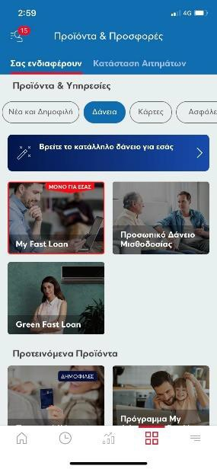
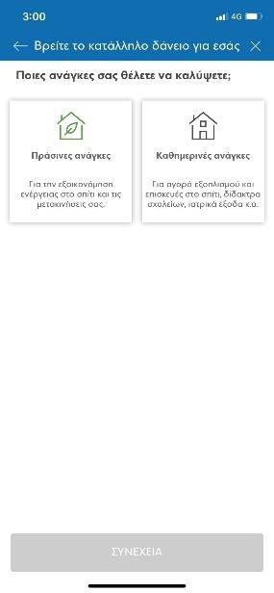
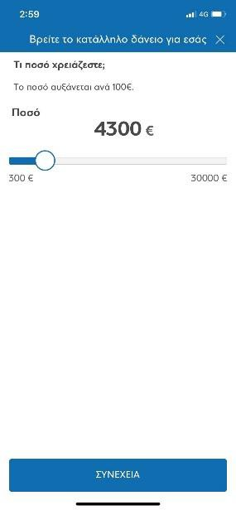
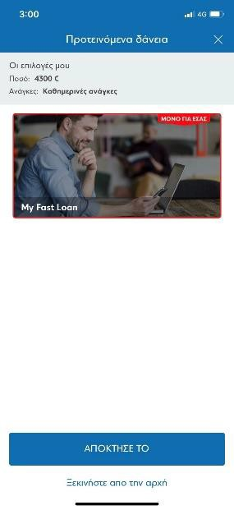
Consumer Loans Strategic Initiatives: Customer Journey Wizard Tool
1
2
3
4
Select wizard
tool
Select need
Select amount
Proposed Product

Slide 13




Consumer Loans Strategic Initiatives – Commercial Plan
Commercial Plan
360 campaigning ecosystems, highly contributing to results and MS leadership
All products, publics, channels & media:
Need Based: e/m always on
Moment of truth: Real time e/m
High Priority publics: Hot Leads, preadvised / preselected
Leader product: Rolling btl campaigns
Pillar 1:
Targeted
Digital ATL (offer related)
Always on / remarketing
www search
Pillar 2:
ATL
ATMs, tablets, e-login, www banners/ tiles, www pages
Pillar 3:
Global Media Awareness Campaigns

Slide 14
Consumer Loans Strategic Initiatives Digital Roadmap
New Wizard tool: One Tile
e-GS loan
My Fast loan
e-PB Prime loan
E-Cash Plus Loan
Green Fast loan
Digital Retailers’ Loan
e-loan (e)
Fast loan
2020
2021
2022
2023
Channels Contribution to Disbursements (#)
Consumer loans digital share increasing mainly due to:
Enhanced product portfolio (i.e: e-GS loan, My Fast loan, PB loan).
One Tile (wizard tool) helping customer choose the appropriate product.
Offering prioritization according to customer’s profile
3

